Slide 1
Presentation Outline for "Cache Bank" Portfolio Piece
Slide 4: Component 3 - Features
Talking Points:
Discuss the use of CSS Flexbox and Grid to design a responsive features section that adapts to screen size.
Explain the application of ARIA (Accessible Rich Internet Applications) roles for accessibility in feature listings.
Slide 5: Component 4 - Stats and Getting Started Section
Talking Points:
Highlight the 'Getting Started' section design to guide users on engaging with Cache Bank's services.
Discuss the CSS layout techniques used to make the 'Getting Started' section and statistics visually appealing and informative.
Highlight the use of JavaScript for animating statistics counters upon scrolling into view.
Slide 6: Component 5 - Contact and Footer
Talking Points:
Discuss the accessibility and design of the footer to complement the overall website design.
Detail the implementation of the contact form using HTML5 form elements and JavaScript for form validation.
Discuss the use of Flexbox or CSS Grid in designing a responsive footer that includes links, privacy policy, terms of use, and social media icons.
Slide 7: Conclusion
Talking Points:
Reflect on the project's objectives and how they were achieved through each component.
Reflect on the technical skills and knowledge gained through working on the project.
Slide 1: Introduction
Talking Points:
Briefly introduce yourself, the project and its objectives.
Overview of the tech stack used (HTML5, CSS3 with Tailwind, JavaScript).
Discuss the initial project setup, emphasizing the organization of the repository for easy collaboration.
Slide 2: Component 1 - Project Setup and Responsive Navigation
Talking Points:
Explain the use of a mobile-first design approach, detailing the CSS media queries for responsive navigation.
Discuss the implementation of an intuitive navigation bar using JavaScript and Tailwind CSS for dynamic resizing and toggling on various devices.
Highlight the use of semantic HTML5 elements for better structure and accessibility.
Slide 3: Component 2 - Hero and Endorsements
Talking Points:
Explain the choice and incorporation of endorsements from credible sources to build trust.
Discuss the call to action in the hero section, guiding users to sign up or learn more.
Detail the creation of the hero section using Tailwind CSS for styling and grid layout for alignment.

Slide 2



SDF Portfolio Piece
CACHE Bank LandingPage
23/04/2023 | Aden Cronje

Slide 3

“
The best error message is the one that never shows up
Thomas Fuchs

Slide 4

Sections of SDF11
Each Component
Introduction and Component 1
Component 2
Component 3
Component 4
Component 5 and Conclusion

Slide 5
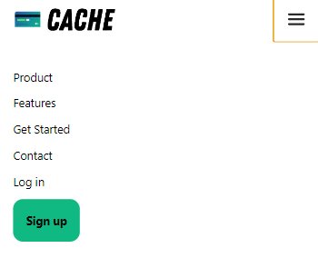
Introduction and Nav-Bar
In this first component I talk a bit about the sites responsiveness and haw I used tailwind and java to make the Navbar work.

Slide 6
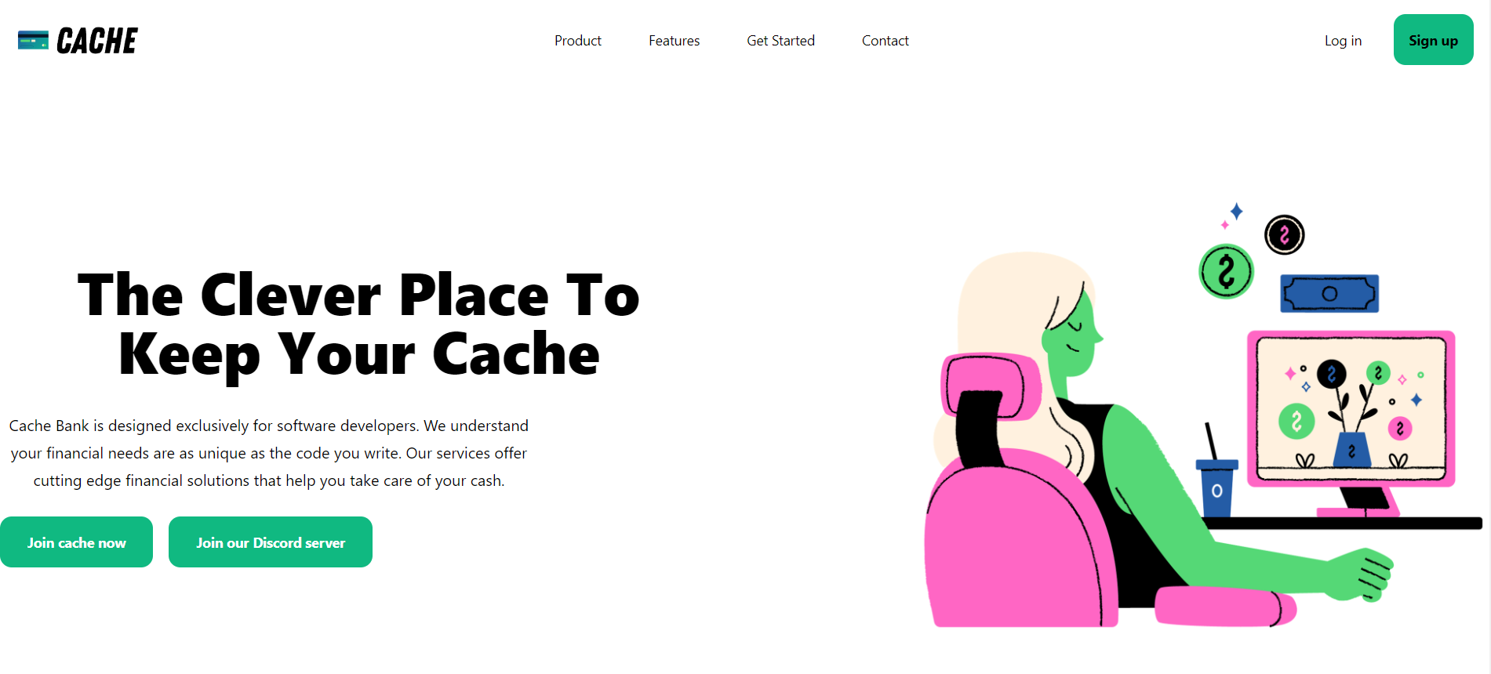

Component 2
In this 2nd component I used the css affects such as hover to achieve the styling seen in the buttons and achieved the spacing between images,endorsements and buttons using grid and flexbox.

Slide 7
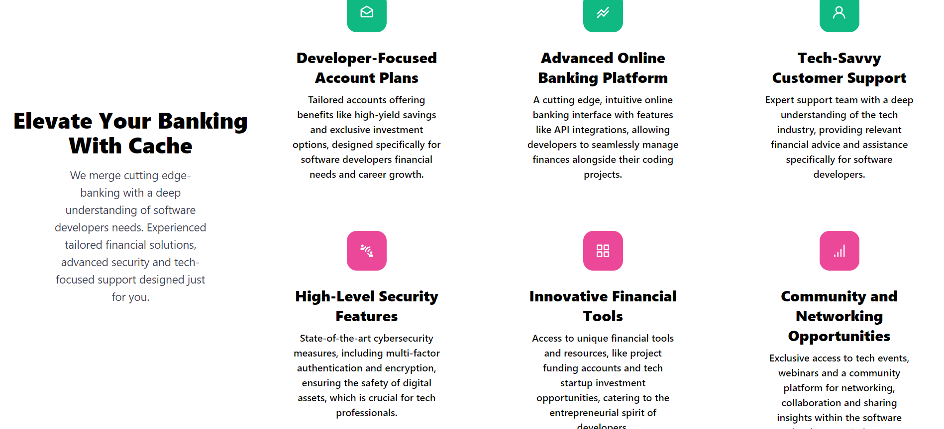
Component 3
In this 3rd component grid and flex was used to achieve this column format for all information. Plus an svg was used for each column.

Slide 8
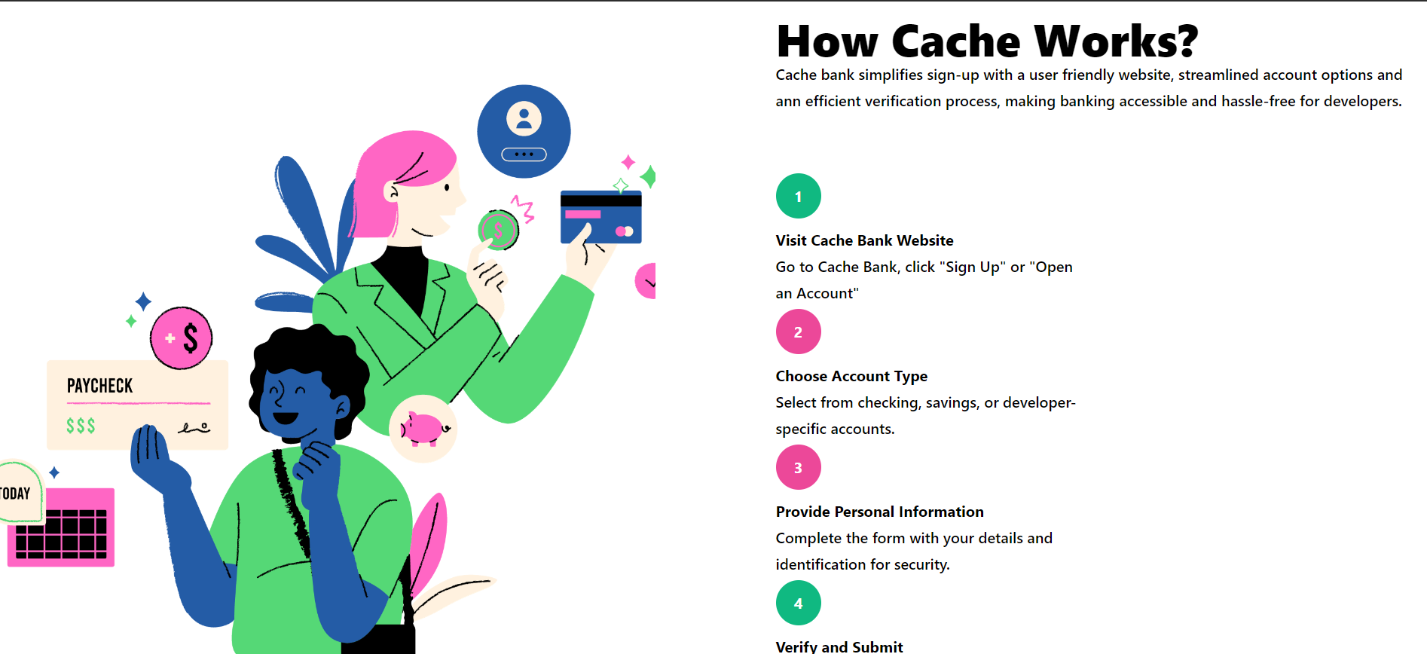
Component 4
In this component the function countto was used to make the numbers count up when the page was reloaded.

Slide 9
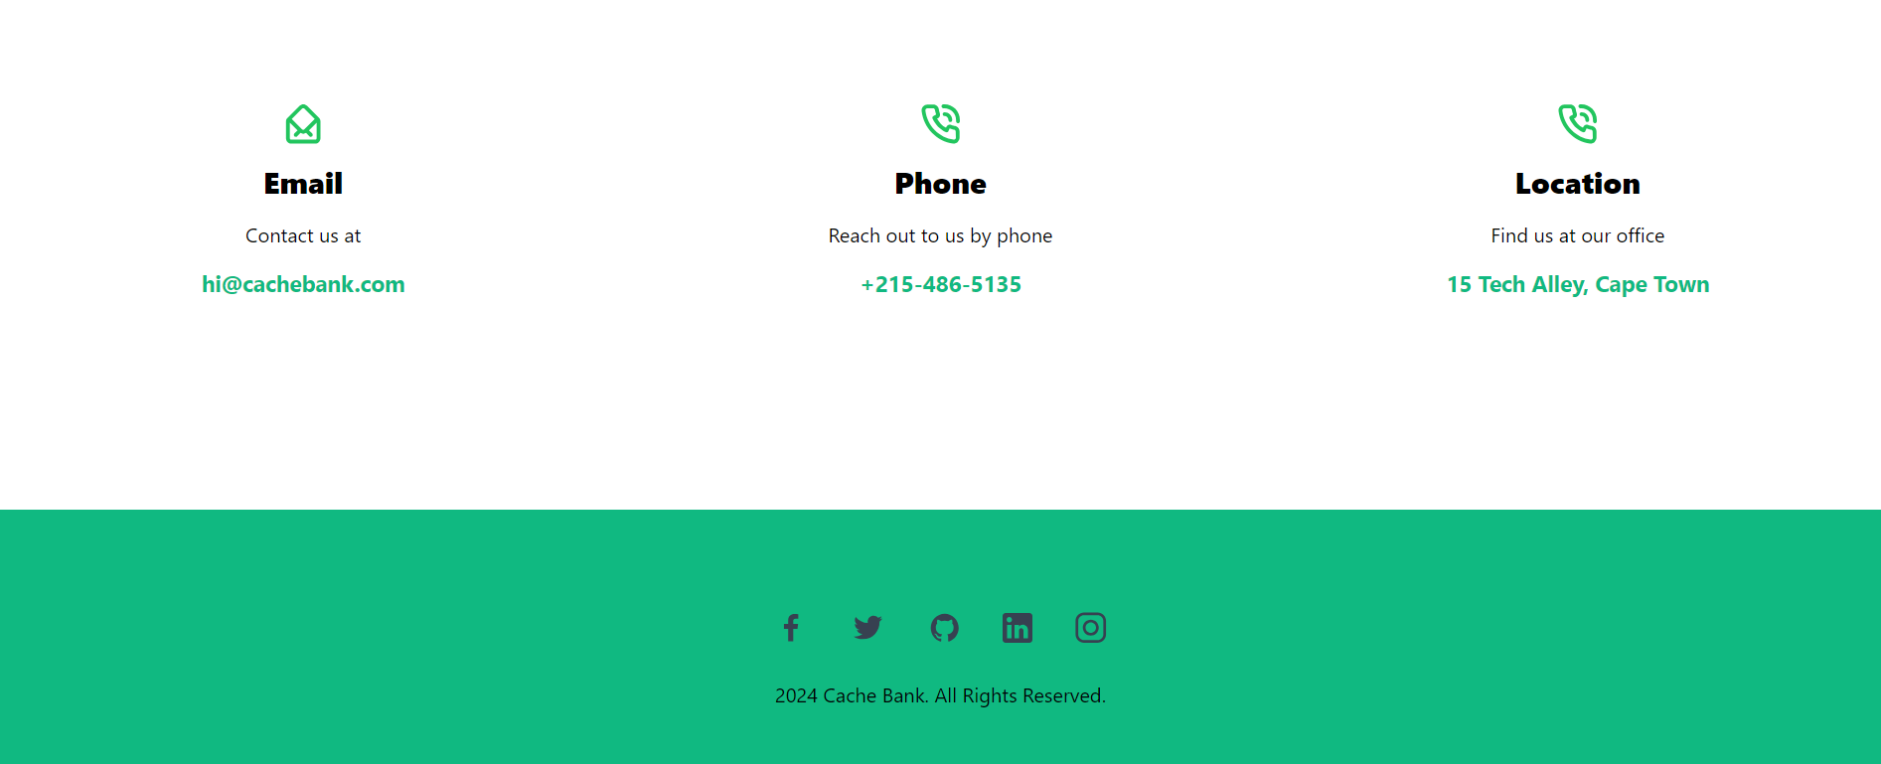
Component 5 and Conclusion
In this final section mainly flex box was used, svg’s with hover effects on them. When clicking on the adress it takes you straight to google maps.

Slide 10

CONTACT
www.codespace.co.za
@codespace_academy
emma@codespace.co.za

